Slide 1

Note: The data and information in this document is reflective of a hypothetical situation and client. This document is to be used for KPMG Virtual Internship purposes only.
Sprocket Central Pty Ltd
Data analytics approach
[Division Name] - [Engagement Manager], [Senior Consultant], [Junior Consultant]

Slide 2
Note: The data and information in this document is reflective of a hypothetical situation and client. This document is to be used for KPMG Virtual Internship purposes only.
Agenda
Introduction
Data Exploration
Data Distribution and Transformation
Feature Engineering
Model Development and Customer Segmentation
Interpretation

Slide 3
Data Quality Assessment
Note: The data and information in this document is reflective of a hypothetical situation and client. This document is to be used for KPMG Virtual Internship purposes only.
Introduction
Accuracy :
Customer demographics : DOB and job industry category columns are inaccurate
Completeness :
Customer demographics : last name, DOB, job title, job industry category, tenure, default columns are not complete.
Transactions : online order, brand, product line, product size, product class, standard cost, product first sold date having null values.
Consistency :
Customer demographics : gender column is inconsistent with representation of gender.
Customer Address : States column is inconsistent with representation of state names.
Currency, Relevancy, Validity :
Customer demographics : Deceased customers and Default columns can be filtered out
Transactions : product first sold date is not in valid format.

Slide 4
Data Cleaning
Note: The data and information in this document is reflective of a hypothetical situation and client. This document is to be used for KPMG Virtual Internship purposes only.
Introduction
Records with null values and useless columns are dropped as they do not show major difference while analyzing the data.
Changed data types to their respective type of data.
Generated transaction month, profit, profit margin columns in transaction table and age, age category columns in customer demographics table.
Made the of gender and state column values consistent.
Label encoding can done on particular columns for future purposes (optional)
Joined all the 3 tables taking customer id as the key. The final table consists of 14054 records which are cleaned.

Slide 5
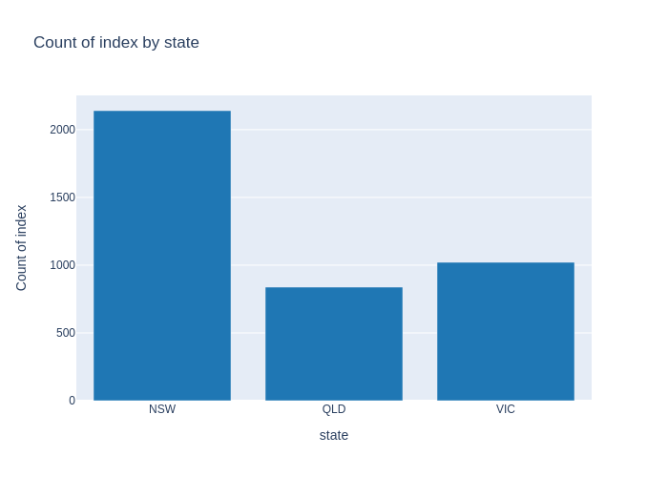
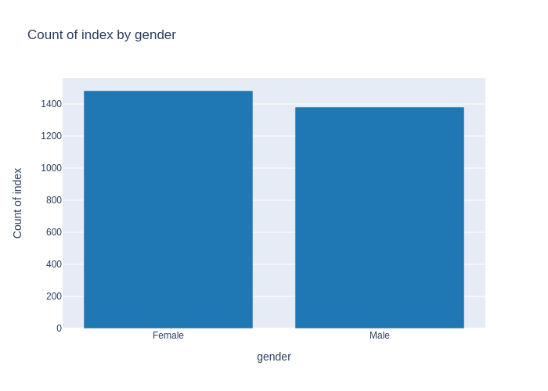
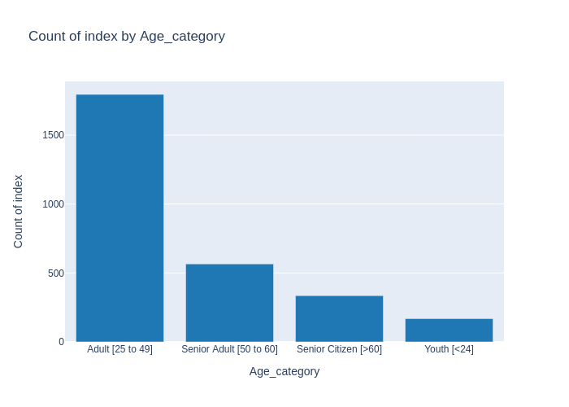
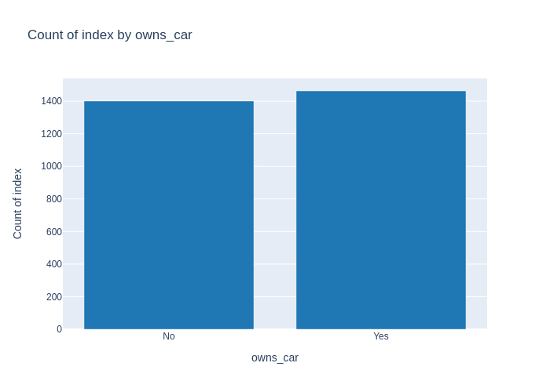
Note: The data and information in this document is reflective of a hypothetical situation and client. This document is to be used for KPMG Virtual Internship purposes only.
Data Exploration

Slide 6
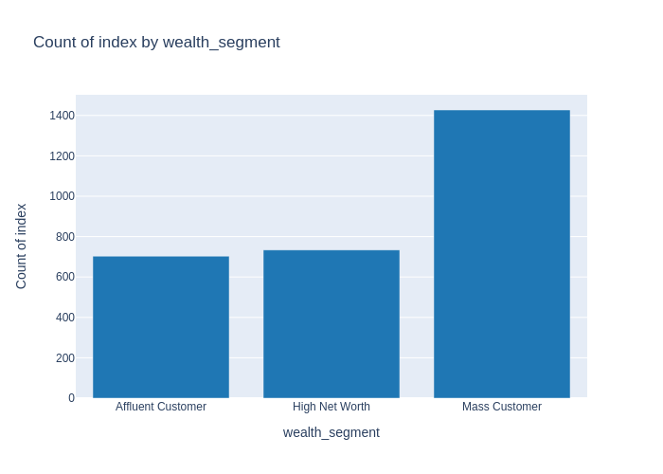
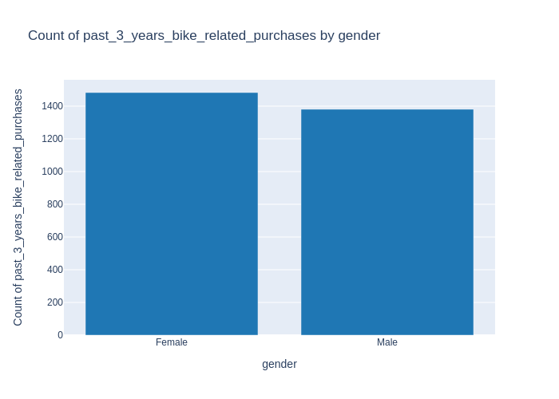
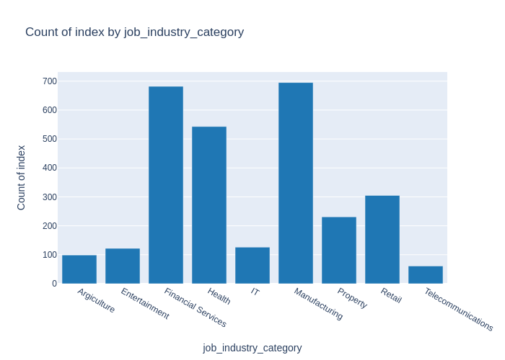
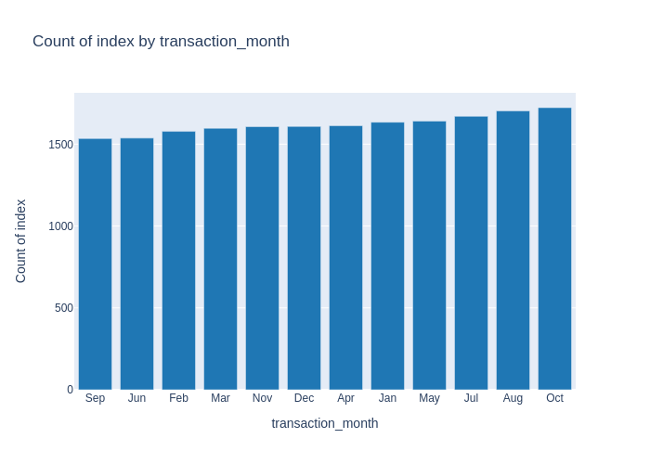
Note: The data and information in this document is reflective of a hypothetical situation and client. This document is to be used for KPMG Virtual Internship purposes only.
Data Exploration

Slide 7
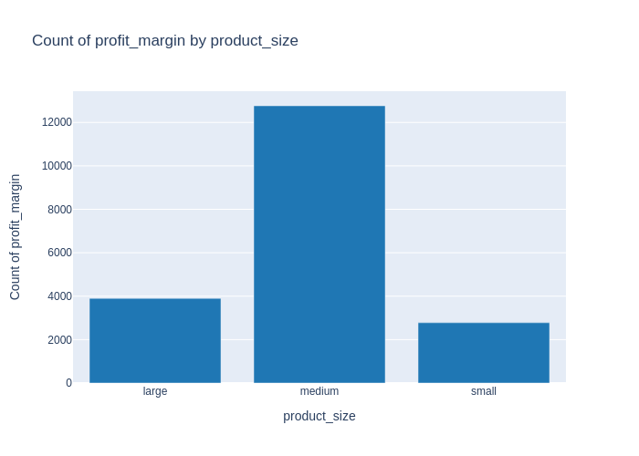
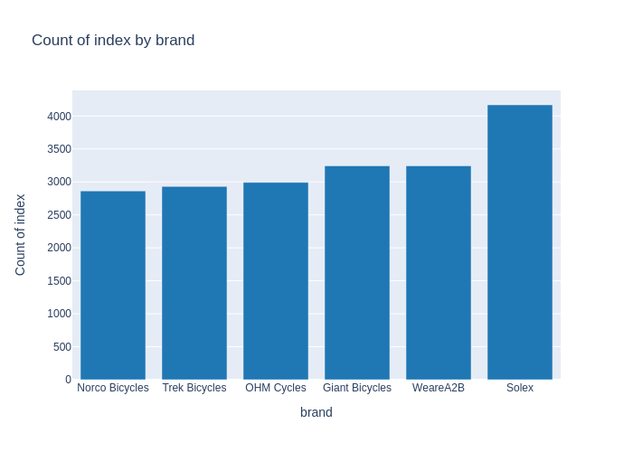
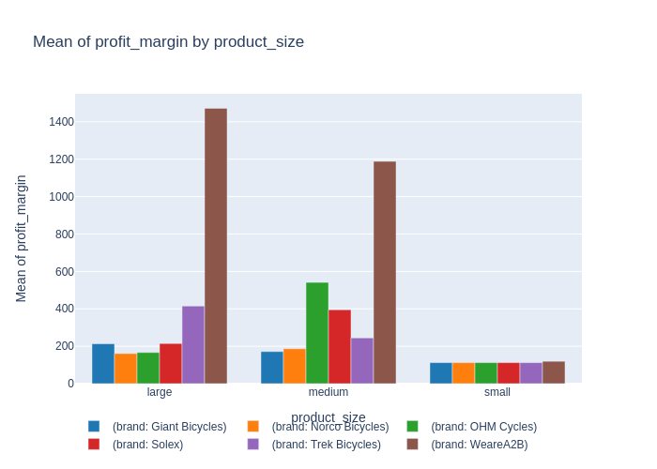
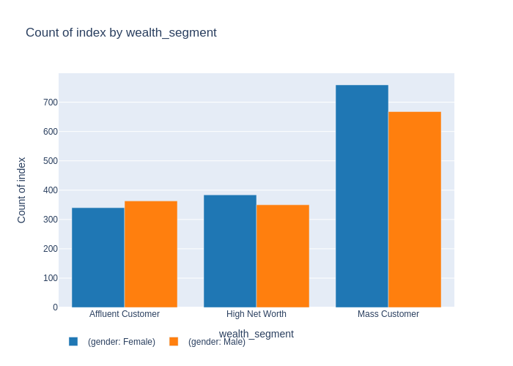
Note: The data and information in this document is reflective of a hypothetical situation and client. This document is to be used for KPMG Virtual Internship purposes only.
Data Exploration

Slide 8
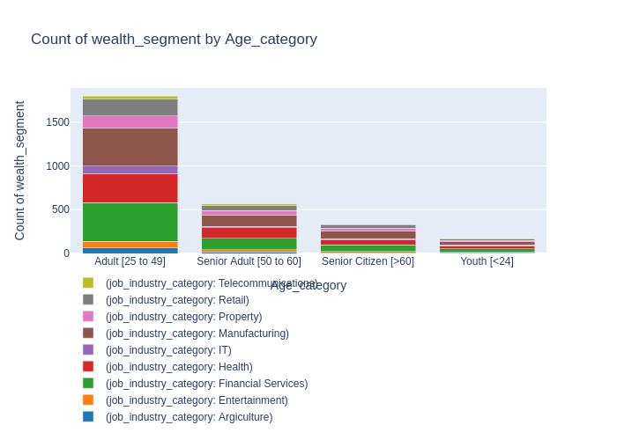
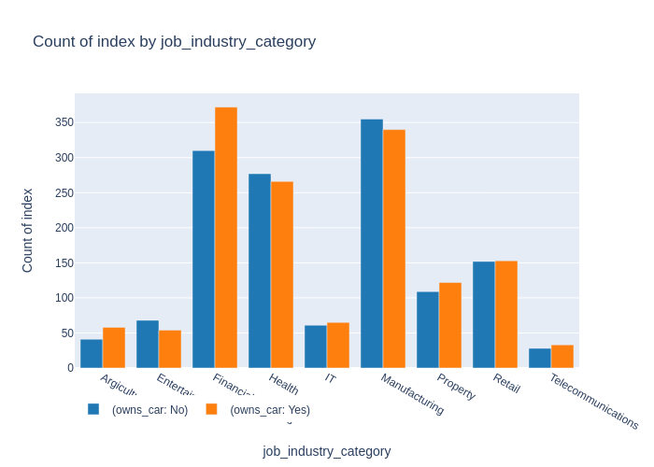
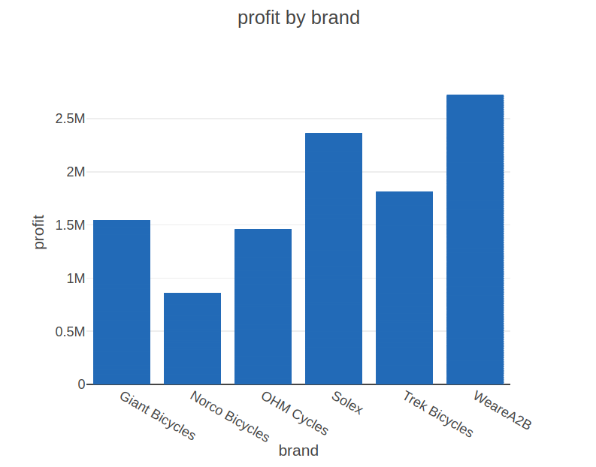
Note: The data and information in this document is reflective of a hypothetical situation and client. This document is to be used for KPMG Virtual Internship purposes only.
Data Exploration
Notes:
Check https://colab.research.google.com/drive/1YSDBlU9xnwSbGLuPlSeVr1lPld8NgUr7?usp=sharing

Slide 9
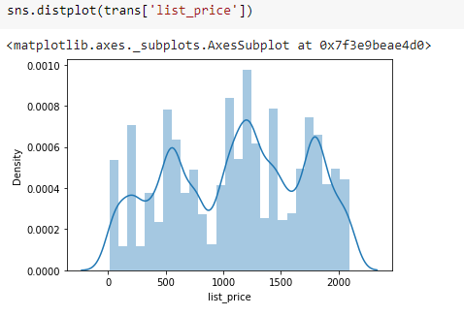
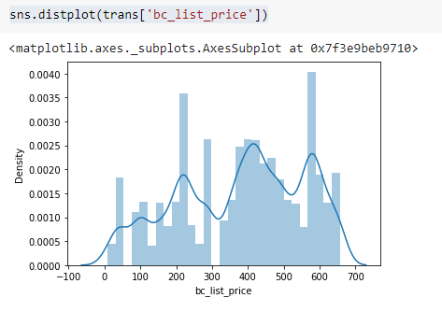
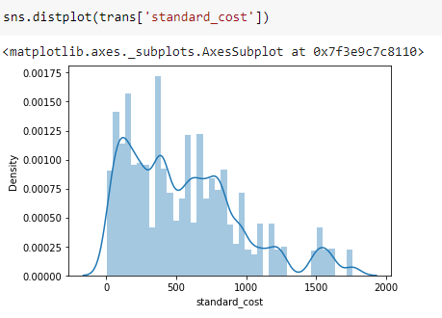
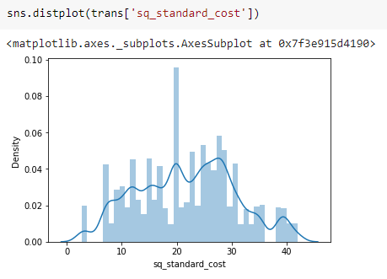
Note: The data and information in this document is reflective of a hypothetical situation and client. This document is to be used for KPMG Virtual Internship purposes only.
Data Distribution and Transformation
1. Transactions table
Applied box cox transformation
Applied square root transformation
Notes:
Best of tested transformation methods were presented.
Check https://colab.research.google.com/drive/1vgR4k-GDJYIsGi_4Y9-BtNxdNkq9LclI?usp=sharing for all other steps tested

Slide 10
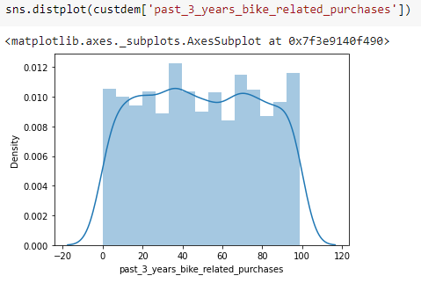
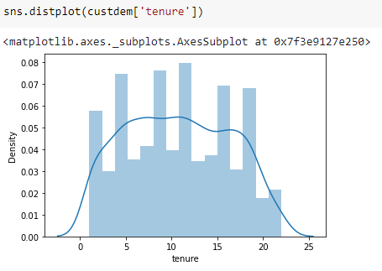
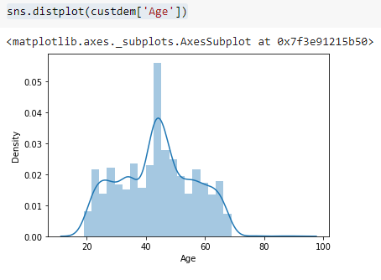
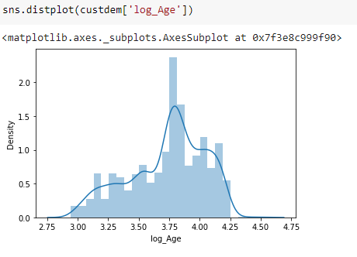
Note: The data and information in this document is reflective of a hypothetical situation and client. This document is to be used for KPMG Virtual Internship purposes only.
Data Distribution and Transformation
2. Customer demographics table
Applied log transformation
Notes:
Best of tested transformation methods were presented.
Check https://colab.research.google.com/drive/1vgR4k-GDJYIsGi_4Y9-BtNxdNkq9LclI?usp=sharing for other methods tested.
Note: no transformations needed for past_3_yeas_bike_related_purchases and tenure columns

Slide 11
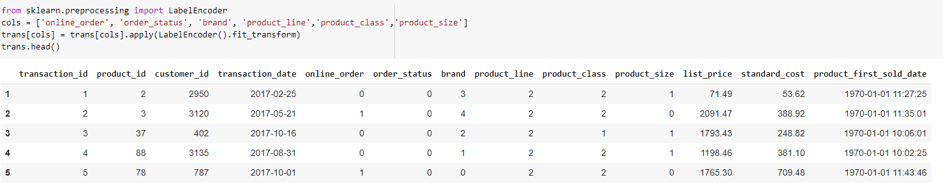
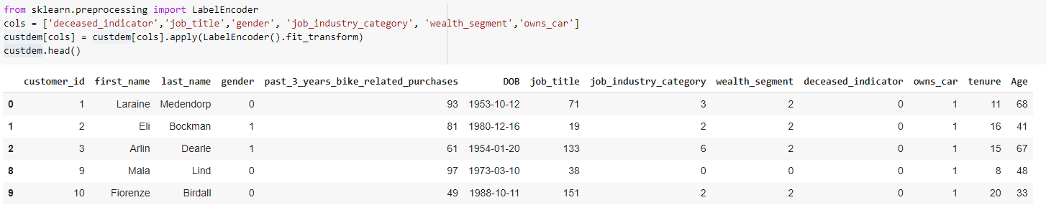
Note: The data and information in this document is reflective of a hypothetical situation and client. This document is to be used for KPMG Virtual Internship purposes only.
Feature Engineering
1.Transactions table
2.Customer demographics
Notes:
Label Encoding is performed in specific columns as shown

Slide 12
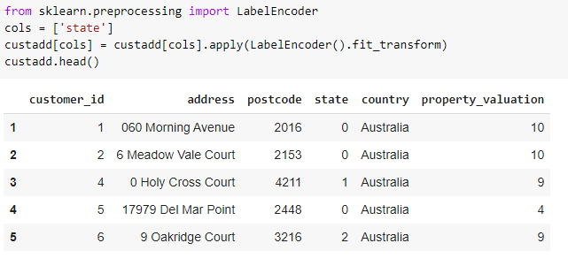
Note: The data and information in this document is reflective of a hypothetical situation and client. This document is to be used for KPMG Virtual Internship purposes only.
Feature Engineering
3.Customer address
Future scope : these feature engineering techniques can be used machine learning model creation in future.
Notes:
Label Encoding is performed in specific columns as shown

Slide 13
Note: The data and information in this document is reflective of a hypothetical situation and client. This document is to be used for KPMG Virtual Internship purposes only.
Model Development and Customer Segmentation
DATA MODELLING :
TASK 1 : NORMALIZATION
Defining keys :
Transactions : (transaction_id, brand,product_line, product_class, product_size)
customer demographics : customer_id
customer address : customer_id
1 NF : all columns must be atomic
Transactions : yes
customer demographics : yes
customer address : yes
2NF : there must be no partial dependency
Transaction : no
solution :
1. product_id, customer_id, transaction_date, online_order, order status depends only on transaction_id so make all these columns into one table with
transaction_id as primary key.
2. list_price, standard_ cost, product_first_sold_date depends only on composite primary key (brand, product_line, product_class, product_size) so make them
into another table.
customer demographics : yes
customer address : yes
3NF : there must be no transitive dependency
Transactions : yes
customer demographics : yes
customer address : yes

Slide 14
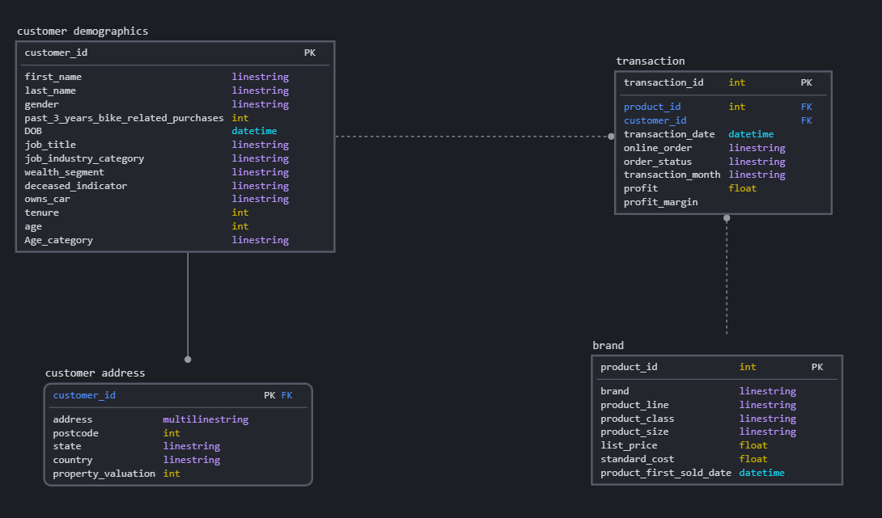
Note: The data and information in this document is reflective of a hypothetical situation and client. This document is to be used for KPMG Virtual Internship purposes only.
Model Development and Customer Segmentation
TASK 2 : DATA MODEL CREATION
Tables after normalization :
1.Transactions
2. Brand
3. customer demographics
4. customer address

Slide 15
Note: The data and information in this document is reflective of a hypothetical situation and client. This document is to be used for KPMG Virtual Internship purposes only.
Model Development and Customer Segmentation
Customer Segmentation :
SQL :
select state,count(*) as total from newcust where state in ('NSW','VIC') group by state order by total desc;
select Age_category, count(*) as total from newcust group by Age_category order by total desc;
select wealth_segment, count(*) as total from newcust group by wealth_segment order by total desc;
select job_industry_category, count(*) as total from newcust group by job_industry_category order by total desc;
select * from newcust where state in ('NSW','VIC') and Age_category='Adult [25 to 49]' and wealth_segment in ('Mass Customer','High Net Worth') and job_industry_category in ('Financial Services','Health','Manufacturing') order by state, wealth_segment desc;
Notes:
Note : the SQL queries were executed on the cleaned dataset which can be found here in this notebook, https://drive.google.com/file/d/10_iHZnWvOEbENJj2Sn_g5M75LyvWHCQr/view?usp=sharing

Slide 16
Note: The data and information in this document is reflective of a hypothetical situation and client. This document is to be used for KPMG Virtual Internship purposes only.
Model Development and Customer Segmentation
Final segmented customers
Notes:
Open the embedded excel sheet for segmented customers

Slide 17
Note: The data and information in this document is reflective of a hypothetical situation and client. This document is to be used for KPMG Virtual Internship purposes only.
Interpretation
After analyzing the data the new customers who are to be more targeted must be
Residents of New South Wales or Victoria
Male or Female
Owning a car or not
Adults in the age between 25 to 49
More prior to mass customer
Working in Financial, Health or Manufacturing industry

Slide 18
Note: The data and information in this document is reflective of a hypothetical situation and client. This document is to be used for KPMG Virtual Internship purposes only.
End

